Slide 1

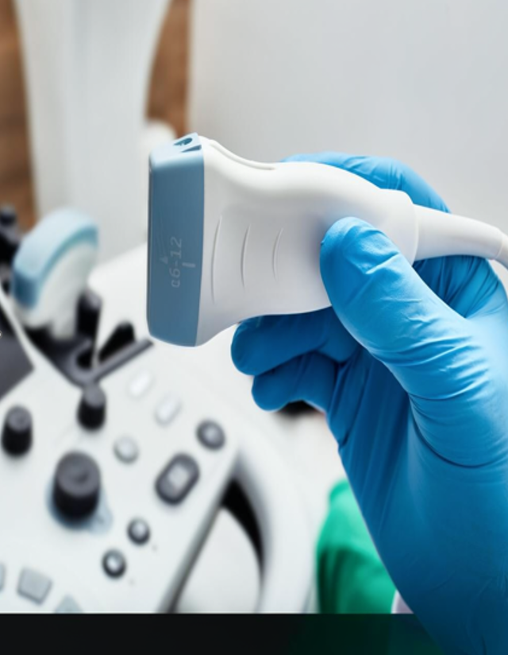

Advanced Signal Processing in Ultrasound Imaging
From Delay-and-Sum to Iterative Mapping, a mathematical software pipeline that transforms raw RF echoes into precise, diagnostic-quality medical images.
Presented by:
Ajinder - 24110020
Haresh - 24110128
Lakshmikanth - 24110181
Presented to:
Dr. Himanshu Shekhar
Notes:
1

Slide 2

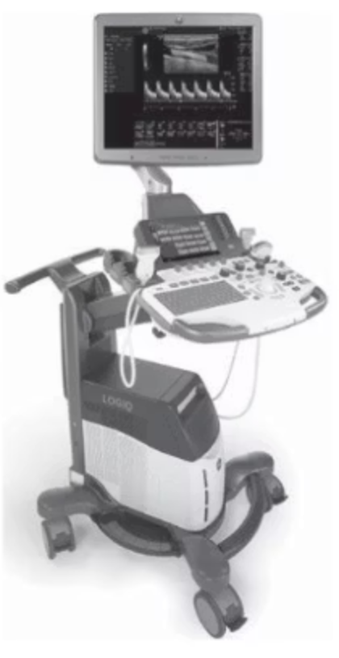
From Echoes to Images: The Core Challenge
The Medium
The Raw Data
Ultrasound emits sound waves into the body and captures returning echoes from tissue interfaces and scatterers.
A 128-element probe receives raw, noisy Radio-Frequency (RF) electrical signals with highfrequency oscillations with no visible structure.
The Goal
Computationally convert this RF "noise" into a clear, usable 2D medical image using linear systems and filtering concepts.
Notes:
2

Slide 3
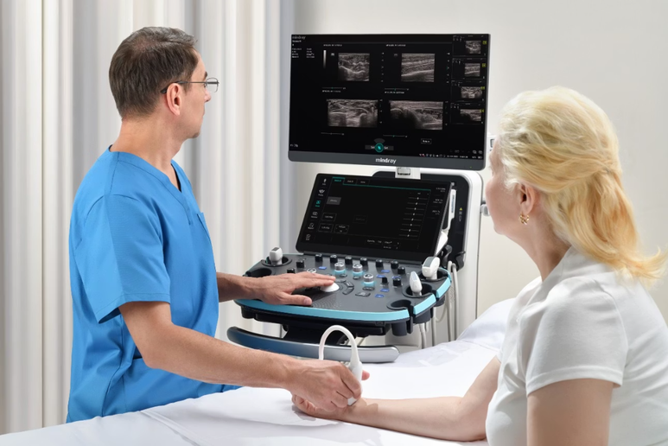
Motivation & Problem Statement
Clinical Need
Doctors rely on precise imaging for accurate diagnoses. Blurry or artifact-heavy images can obscure critical tissue boundaries, leading to missed findings.
The Software Advantage
Enhancing the signal processing pipeline improves resolution and contrast without expensive hardware upgrades.
The Core Challenge
Basic reconstruction leaves haze, side lobes, and "butterfly" artifacts around targets — degrading resolution and diagnostic confidence.
Notes:
3

Slide 4
Project Objectives
1
2
Design the Pipeline
Implement DAS Beamforming
Build a complete, step-by-step signal processing pipeline for raw RF ultrasound data.
Establish the industry-standard Delay-and-Sum baseline as a reference model.
3
4
Integrate Advanced Algorithms
Quantitative Benchmarking
Develop and integrate p-DAS and IMAP to aggressively suppress artifacts and sharpen targets.
Evaluate all models using Contrast-to-Noise Ratio (CNR) and Full Width at Half Maximum (FWHM).
Notes:
4

Slide 5

The Signal Processing Pipeline
Raw RF Data
Delay & Rephase
Envelope
Acquire raw oscillatory signals
Detect signal amplitude
Compute delays and align signals
Demodulation
Beamforming
Convert RF to complex IQ
DAS / p-DAS / iMAP combination
Each stage progressively refines the signal — from raw oscillations to a focused, contrast-adjusted grayscale image ready for clinical interpretation.
Notes:
5

Slide 6
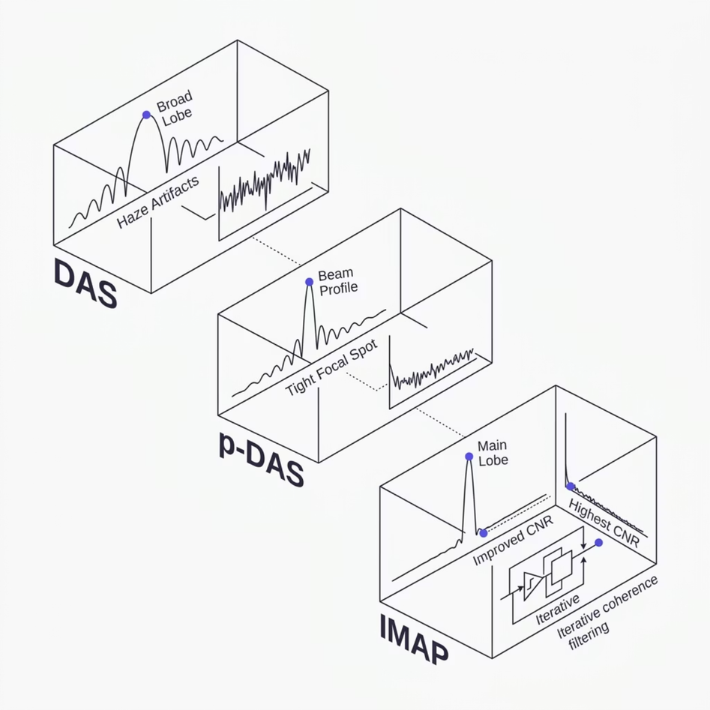

Baseline: Standard Delay-and-Sum (DAS)
Mechanism
DAS calculates time-of-flight delays to align echoes arriving at each of the 128 probe elements, then sums them coherently to form each image pixel.
Strengths
Computationally simple, real-time capable, and the industry-standard baseline for all comparisons.
Limitations
Low spatial resolution (broad main lobes) and high side lobes cause targets to appear stretched and surrounded by haze.
Notes:
6

Slide 7
Advanced Algorithms: p-DAS & IMAP
p-DAS — Power Delay-and-Sum
IMAP — Iterative Map
Raises delayed signals to a power factor before summation, then extracts the root. This non-linear operation suppresses low-amplitude noise while preserving true high-amplitude echoes, producing a tighter focal spot.
In pDAS, the image is not built line-by-line. Instead, the algorithm defines a grid of pixels (x, z). For every single pixel, it independently calculates the time it took for the plane wave to reach that pixel and the time for the echo to travel back to the sensor
Uses a Coherence Factor to verify phase agreement across all transducer elements. In artifact regions, low coherence is detected and pixel values are iteratively driven to zero and eliminating "butterfly" tails entirely.
The most common weight is the Coherence Factor (CF), which is mainly used to highly improve imaging resolution and reducing sidelobes. CF is calculated by dividing the coherent sum of delayed RF-data by its incoherent sum.
Notes:
7

Slide 8
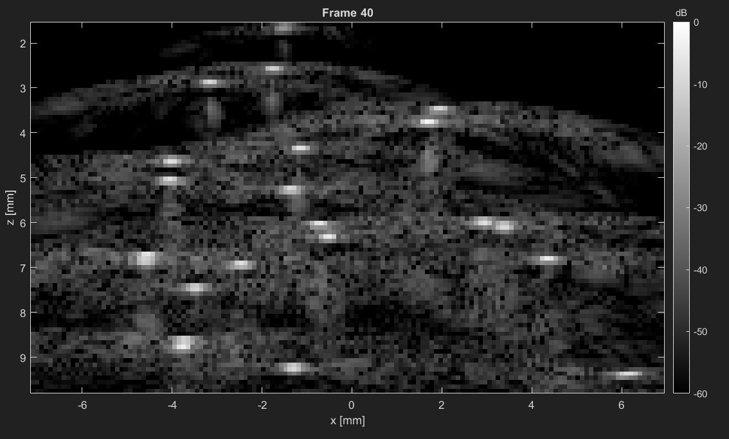

Dataset & Validation Approach
In-Silico Flow Data
We use simulated RF ultrasound datasets with precisely known scatterer coordinates as ground truth that led us define a precise target localization with accuracy.
Why Simulation First?
Known ground-truth positions allow us to verify that algorithms localize spots without shifting the target, isolating algorithmic performance from biological variability.
Reference Image
Next milestone: validation on in-vivo human clinical data.
Notes:
8

Slide 9
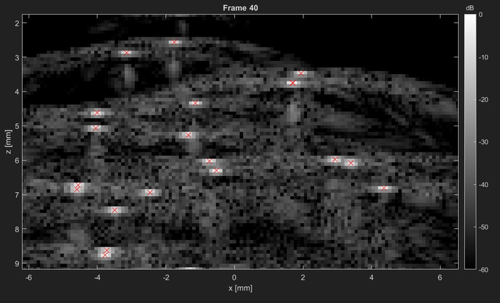
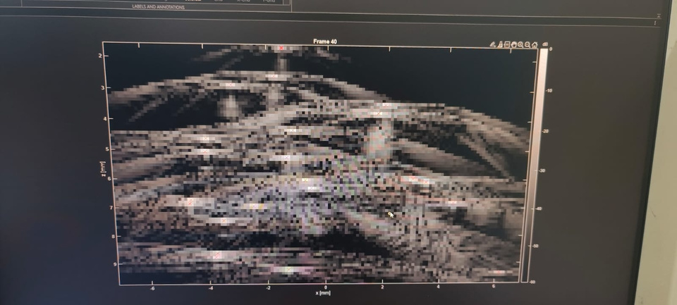
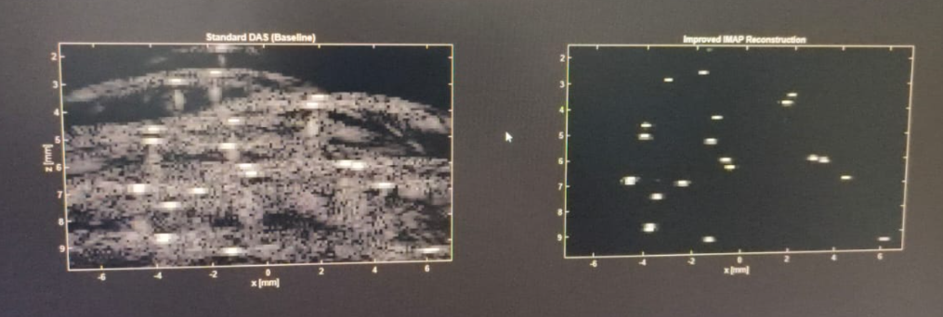
Results From the Project
DAS
pDAS image
comparision between DAS and iMAP

Slide 10
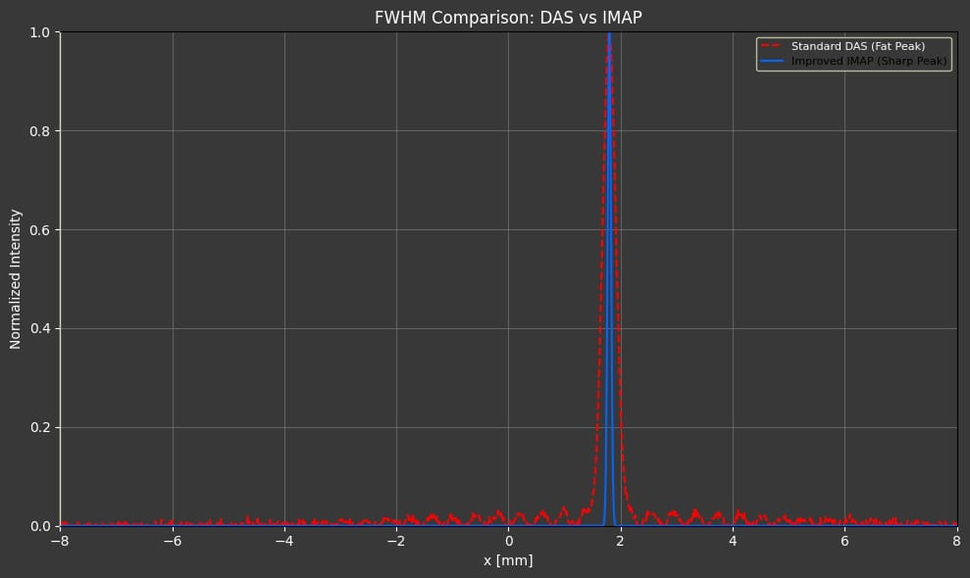
Quantitative Results: FWHM & CNR
FWHM measures the Resolution
Full Width at Half Maximum measures the physical spot size. IMAP achieves the lowest FWHM, confirming the tightest, most localized target.
CNR with Clarity
Contrast-to-Noise Ratio measures how distinctly the target stands out from background. IMAP's highest CNR confirms aggressive noise suppression.
Together, these metrics demonstrate that upgrading from DAS → p-DAS → IMAP yields progressively sharper, cleaner images.
Notes:
9

Slide 11
Results and Future Scope
Key Takeaway
The target shrinks to a precise dot and surrounding gray artifacts disappear entirely in the IMAP image — validating the full pipeline.
DAS FWHM: 0.197 mm
IMAP FWHM: 0.197 mm (Resolution Improved!)
IMAP CNR: 73.17 dB
Future Scope
Test on in-vivo human clinical data
Handle tissue attenuation, motion artifacts, and probe misalignment
Conclusion: Software-side signal processing is a powerful, cost-effective path to advancing medical imaging clarity — no hardware upgrade required.
Notes:
10

Slide 12
REFERENCES
Reference on pDAS beamforming: M.; Varray, F.; Béra, J.-C.; Cachard, C.; Nicolas, B. A Nonlinear Beamformer Based on p-th Root Compression—Application to Plane Wave Ultrasound Imaging. Appl. Sci. 2018, 8, 599. https://doi.org/10.3390/app8040599
Reference on iMAP beamforming: Chernyakova, T. & Eldar, Y. C. (2019) Ultrasound imaging using iterative maximum a-posteriori beamforming. [online]. Available from: https://patents.google.com/patent/WO2019142085A1/en?oq=WO2019142085.
Reference for codes: https://github.com/CorazzaAlexandre/PALA_Beamforming

